Slide 1
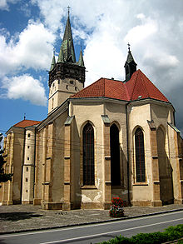
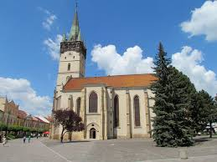
Cathedral of Saint Nicholas

Slide 2
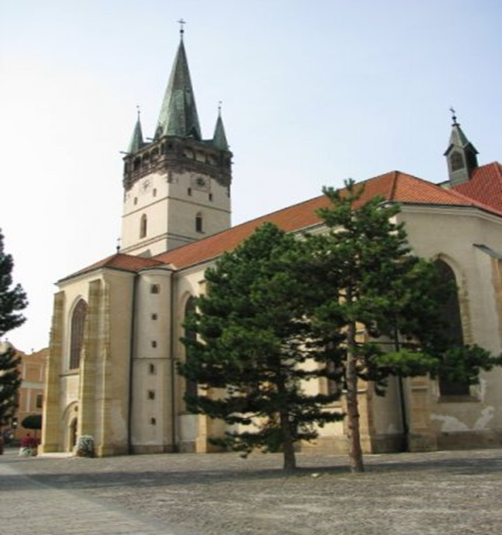
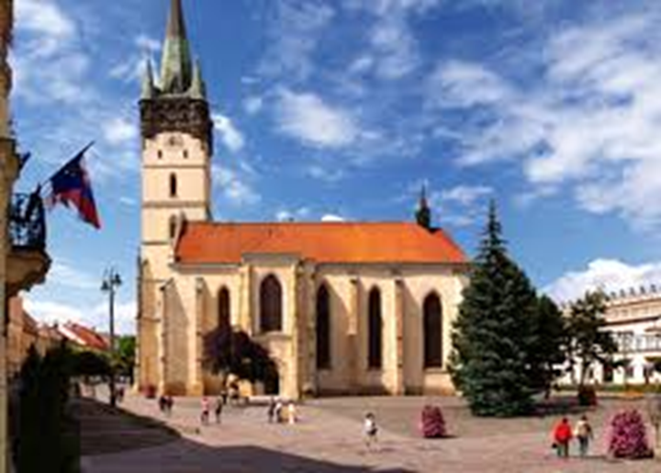
the principal architectonic and historic landmark of town Prešov
the oldest and the only Gothic religious building preserved in the town

Slide 3
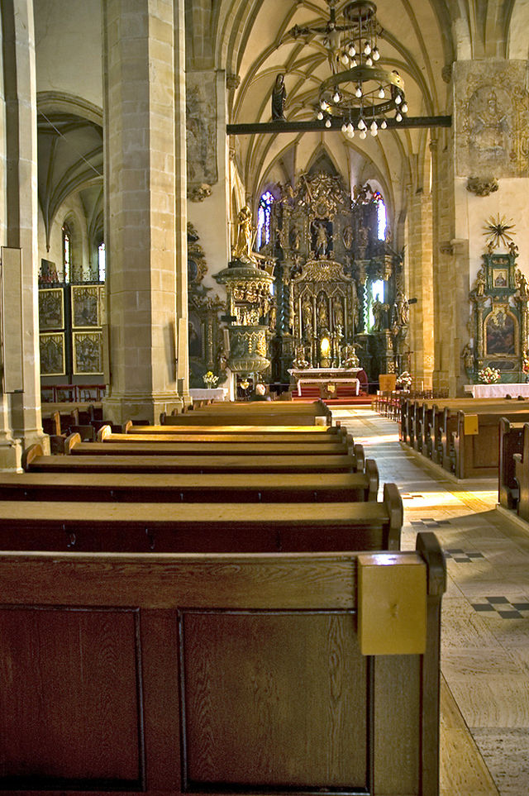
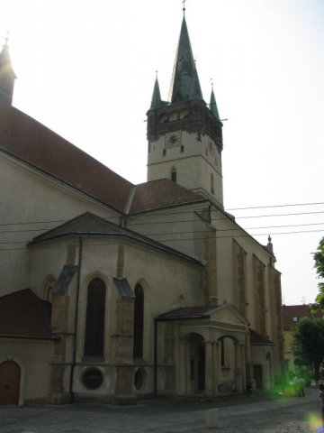
construction of the Gothic church was finished in 1515
three-nave Gothic design, also called " hall church"

Slide 4
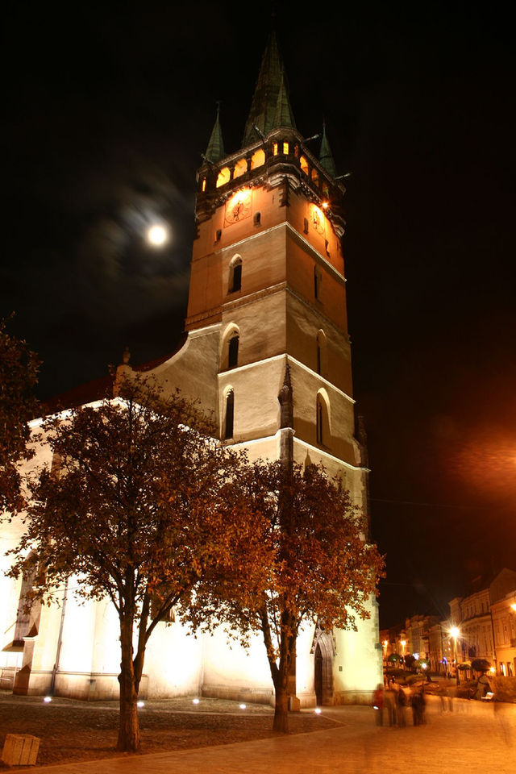
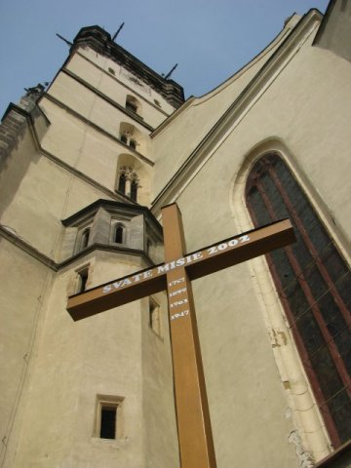
by its size it holds the 3rd position among buildings of the same type in Slovakia after the Levoca church of St. James and Bratislava's St. Martin Cathedral.

Slide 5
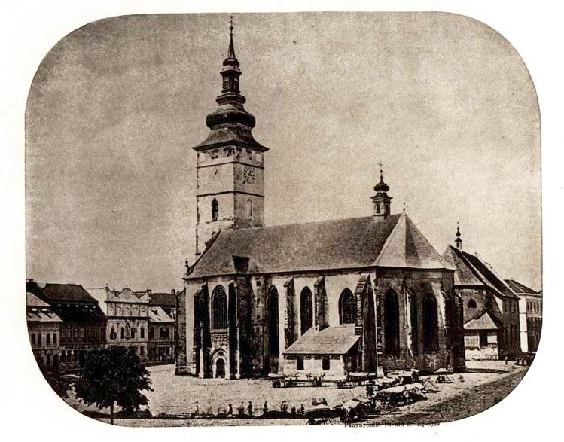
parish church until 2008
2008 - it was elevated by pope Benedict XVI to the co-cathedral church

Slide 6
Ďakujem za pozornosť
Matej Pošefko 1.D

